Slide 1

eAuto – Bike Spare Parts E-Commerce Platform

Slide 2
1. Introduction
2. Aim of the Project
3. Features of the Project
4. System Analysis & Design
5. ER Diagram
6. Data Flow Diagram (DFD)
7. Flow Charts
8. Implementation Details
9. Testing
10. Limitations of the Project
11. Conclusion
12. References

Slide 3
Project
Introduction
Background of the Project – Short description of the problem domain and why the project was initiated.
Purpose of the Project – What the system aims to achieve and its importance.
Scope of the Project – Boundaries of the system, what it will and will not cover.

Slide 4
Project Benefits
Objectives – Clear, measurable goals of the system.
Advantages of the System – Key benefits like automation, user convenience, admin control, etc.

Slide 5
Aim of the Project
Statement of Aim – Clearly defines what the project intends to achieve.
Importance of Aim – Explains why the aim is necessary and valuable.
How Aim Solves Current Problems – Shows how the project overcomes existing system drawbacks.

Slide 6
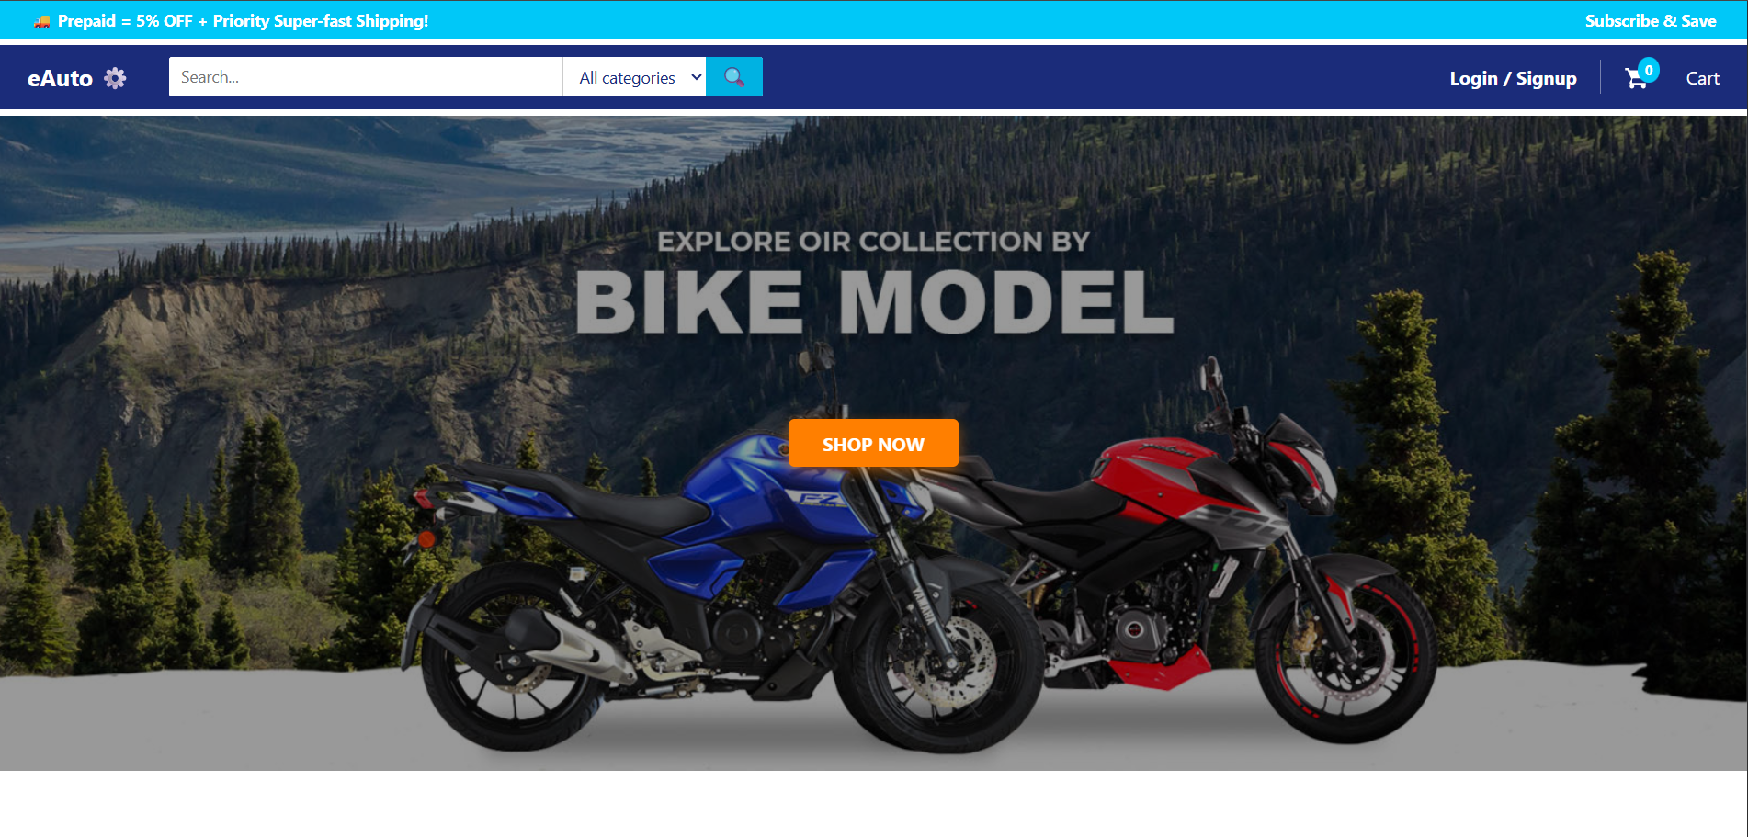
Features of the Project
Content: Brief overview → “The system provides features for both Users and Admins to ensure smooth e-commerce operations.”

Slide 7
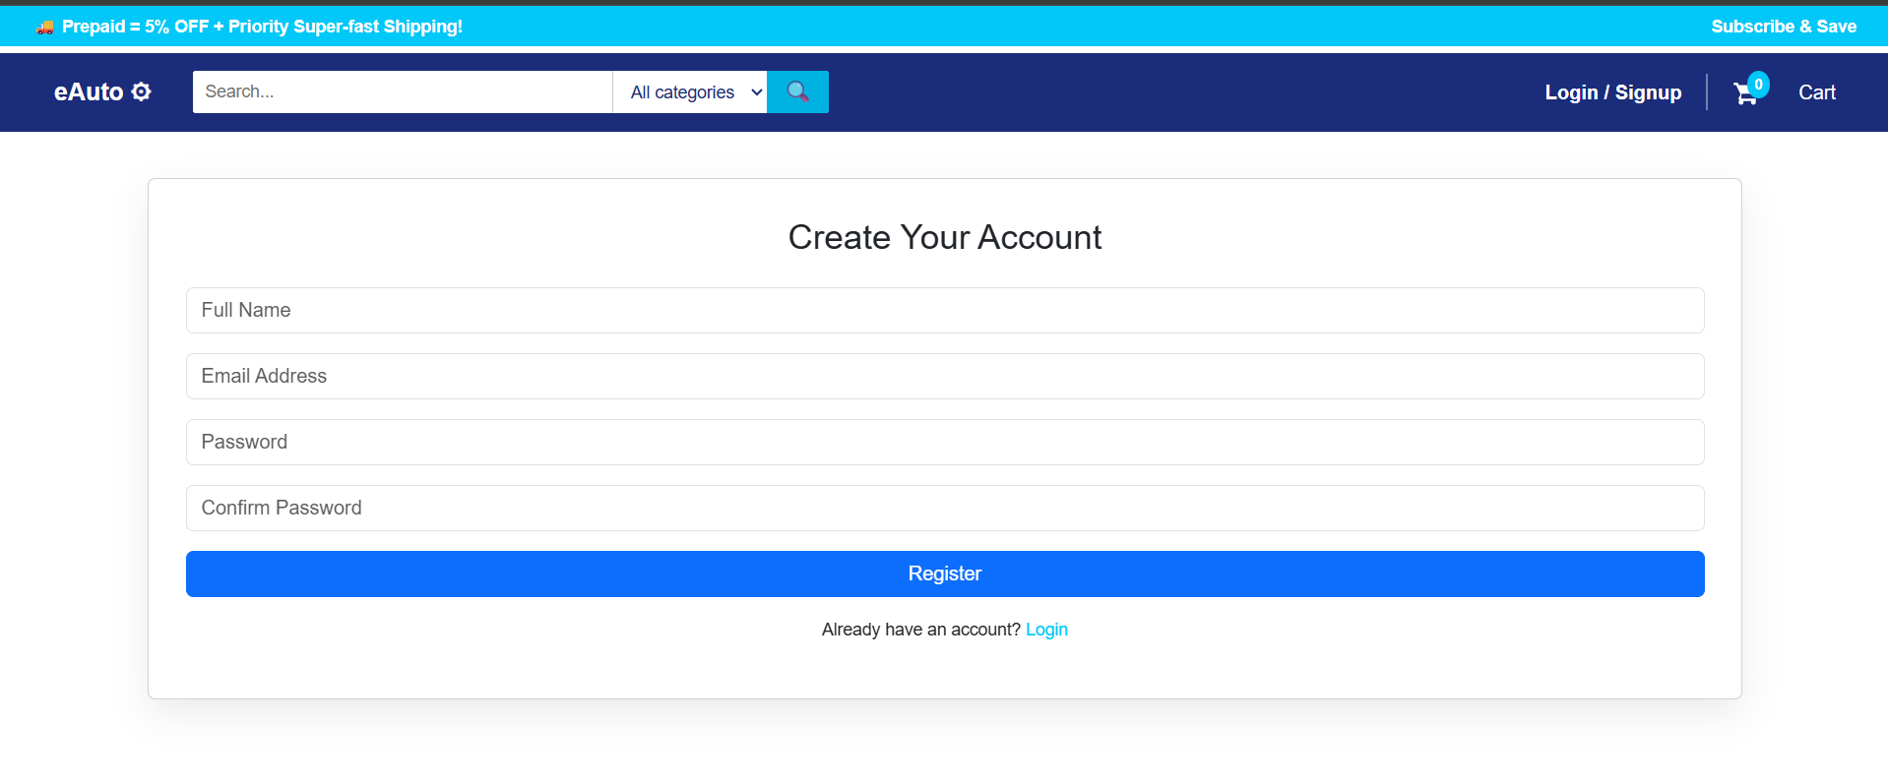
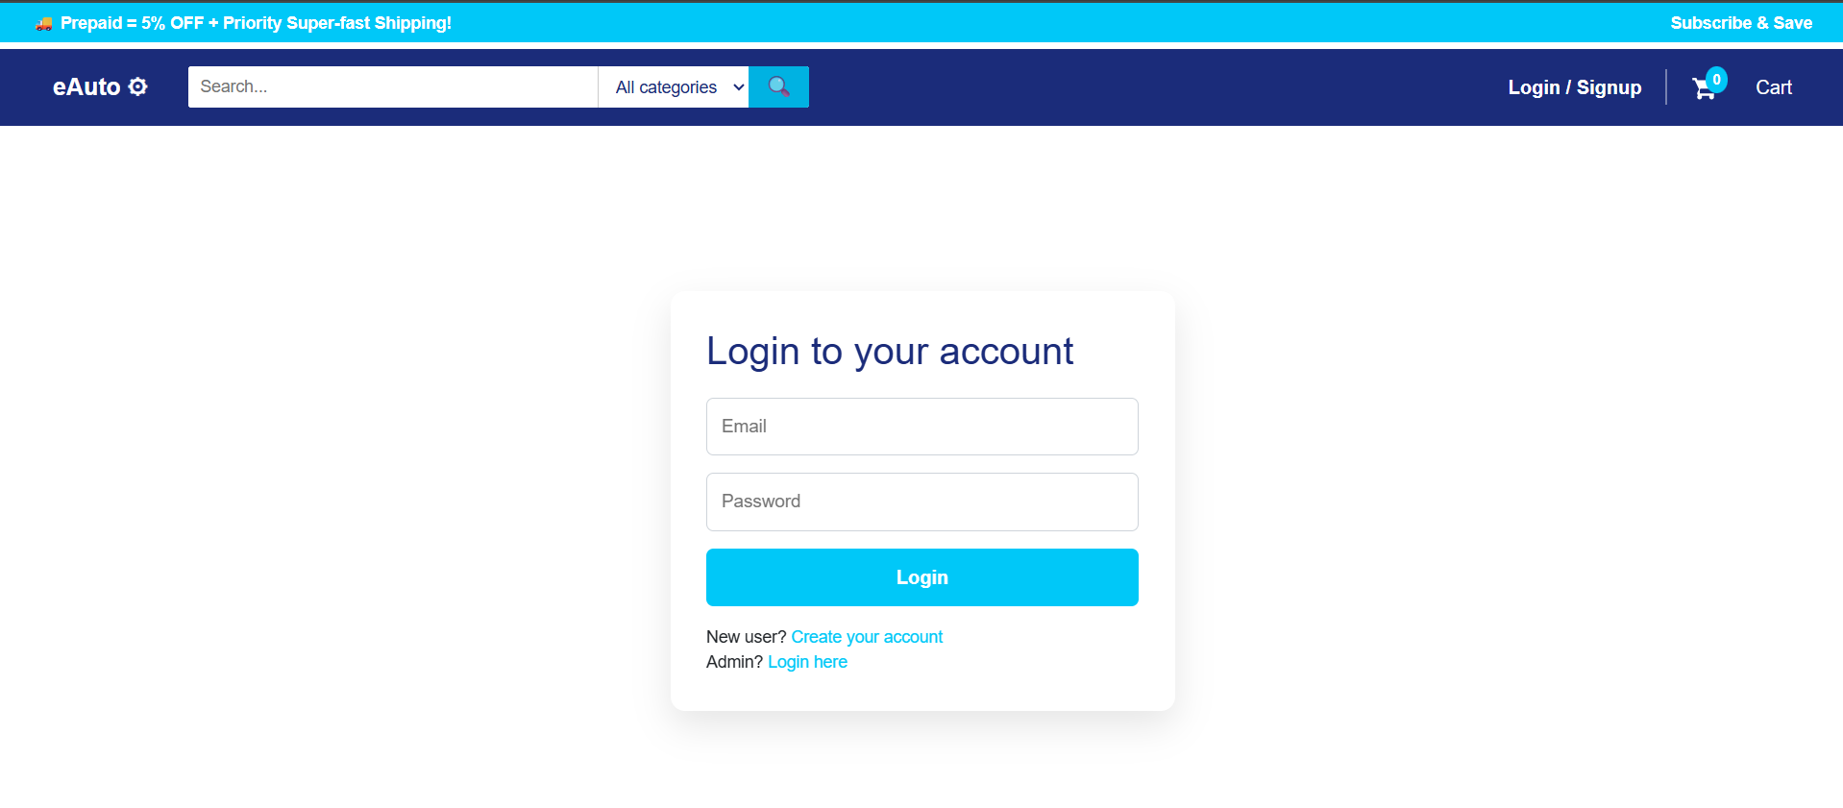
User Feature1:
Registration &
Login
Secure authentication
User session management

Slide 8
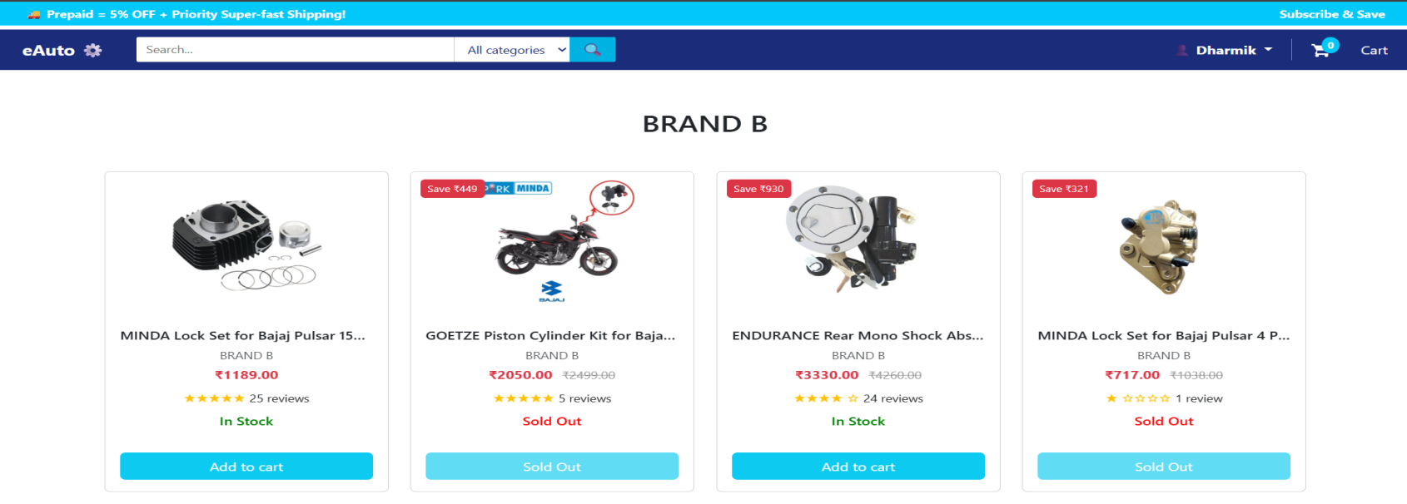
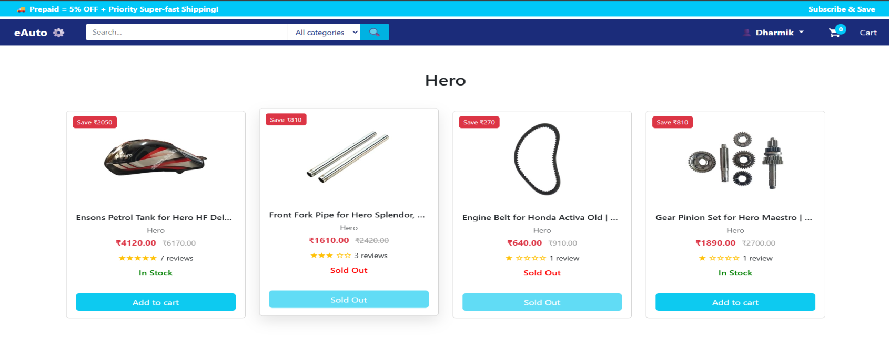
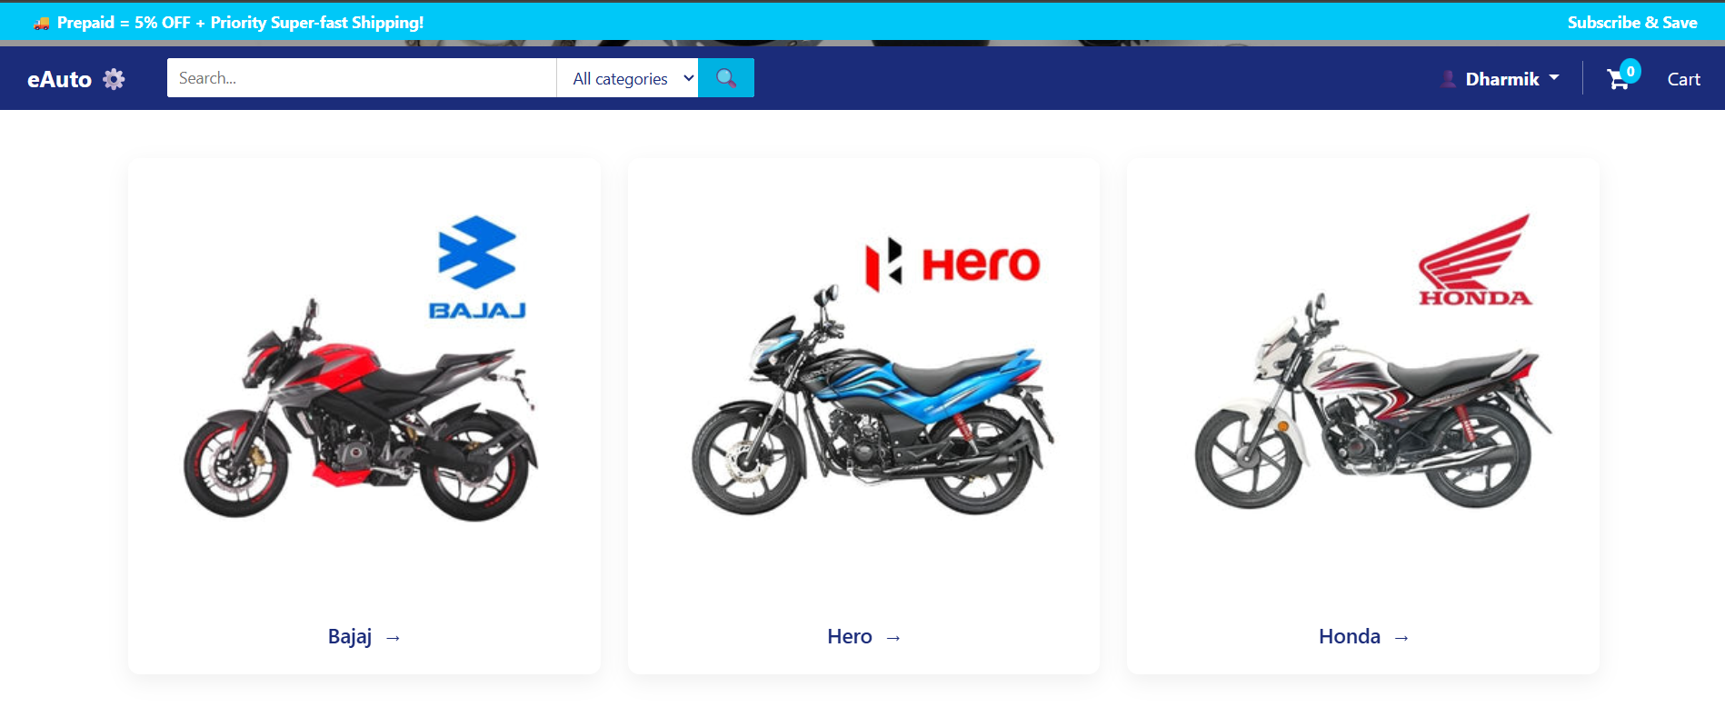
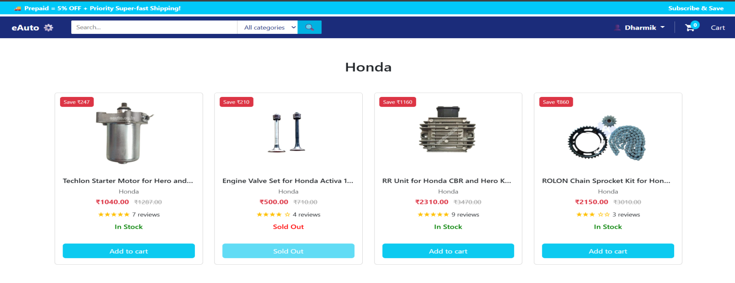
User Feature 2:
Browse & Search
Products
Search by brand/category
Product filtering & sorting

Slide 9
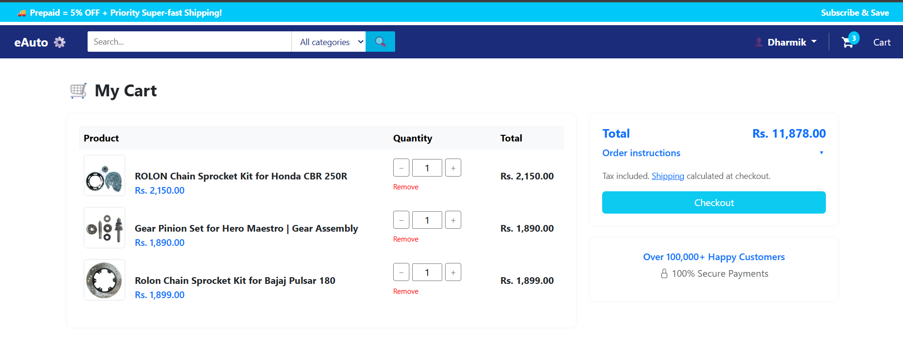
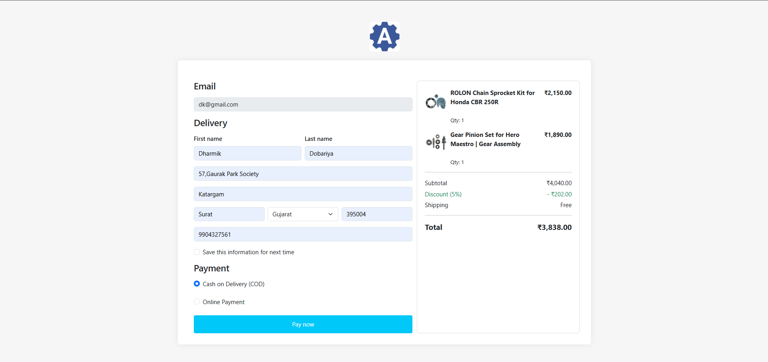
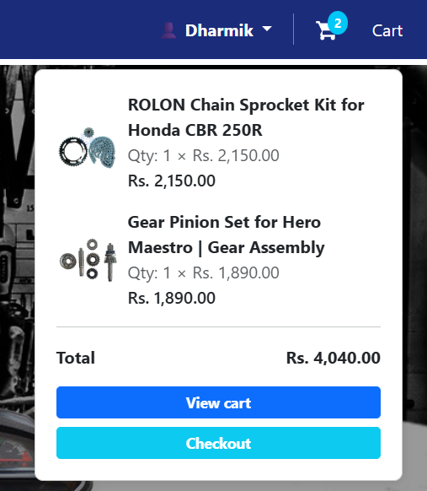
User Feature 3: Cart & Checkout System
Add/remove products from cart
Secure checkout process

Slide 10
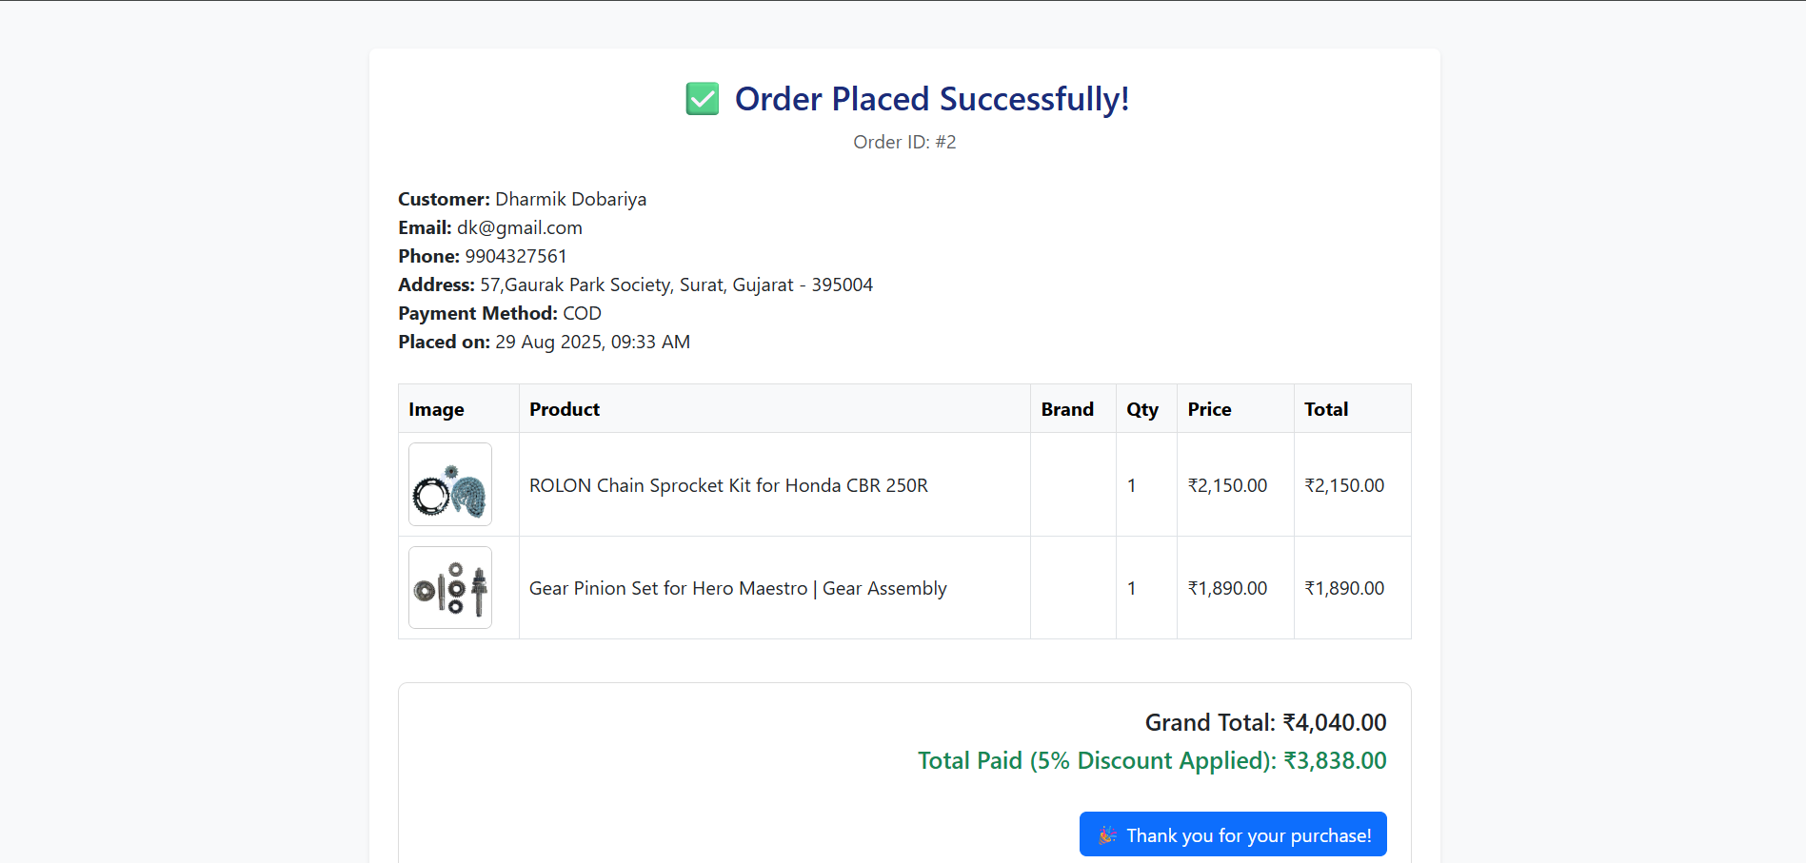
User Feature 4: Order Tracking
Real-time order status
Delivery updates

Slide 11
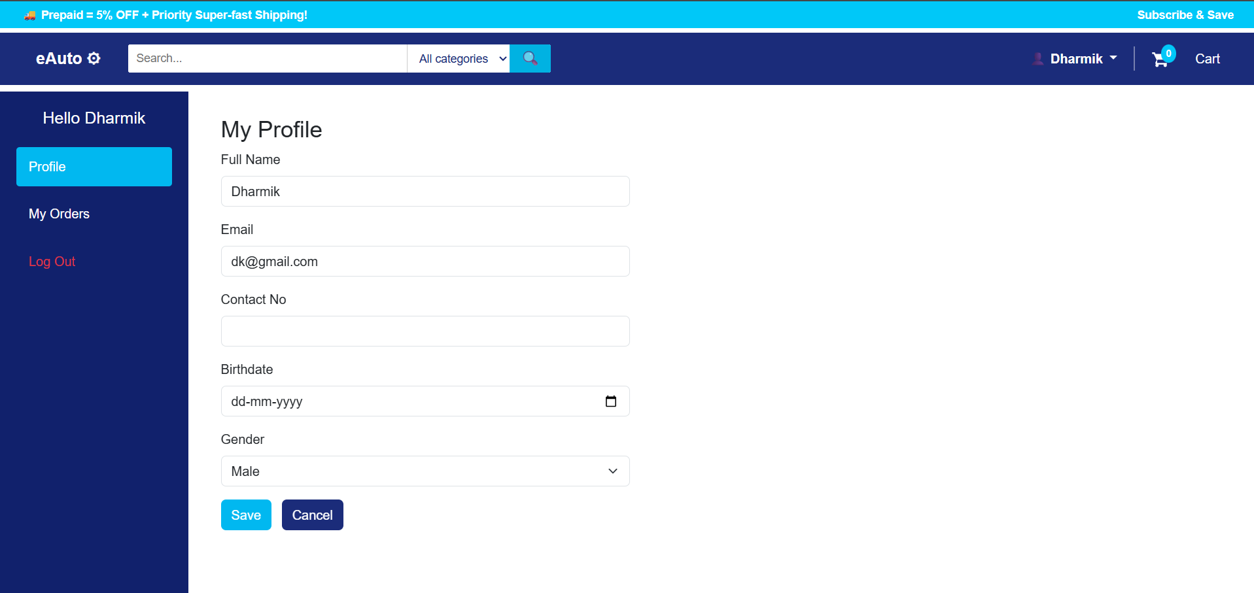
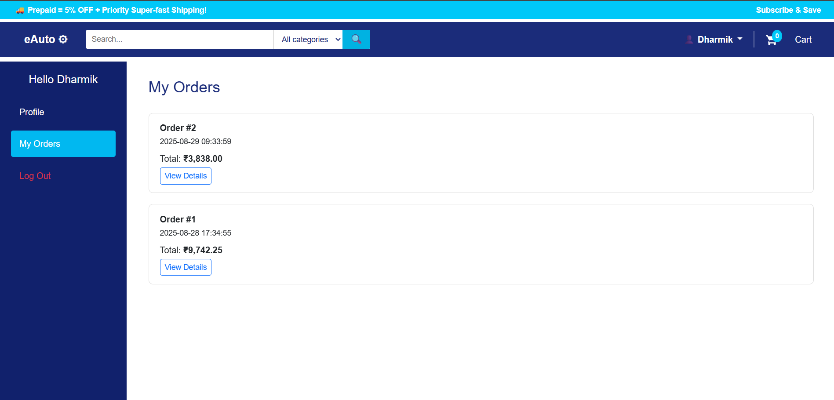
User Feature 5:
Profile &
My Orders
Manage personal info
View details my orders

Slide 12
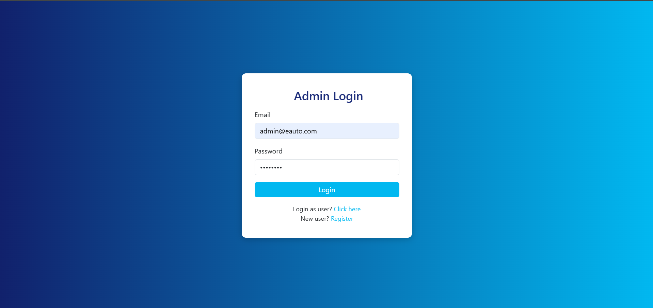
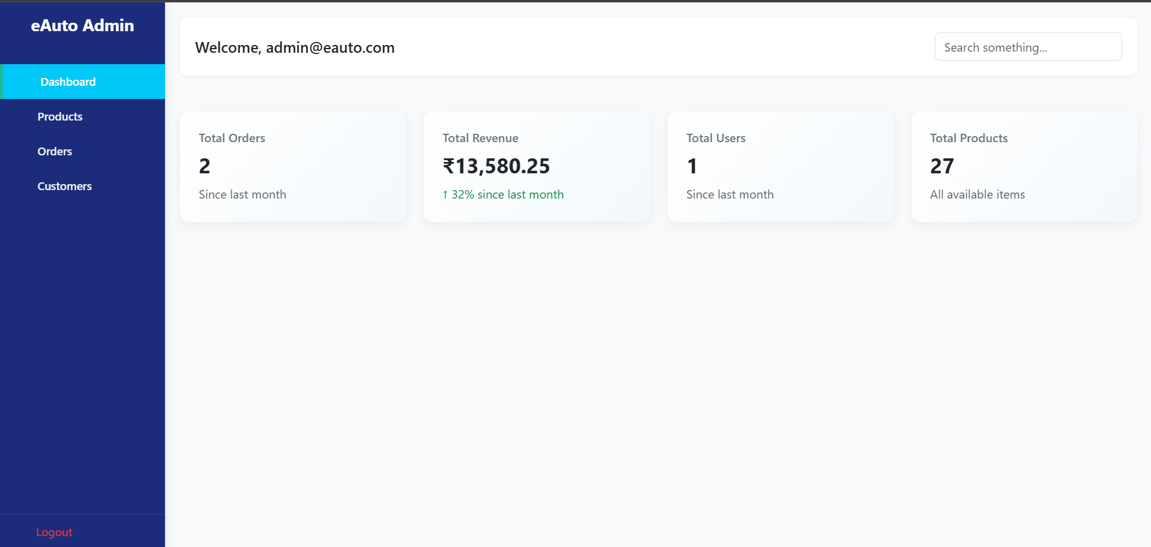
Admin Feature 1:
Admin Login & Dashboard
Secure admin authentication
Centralized dashboard view

Slide 13
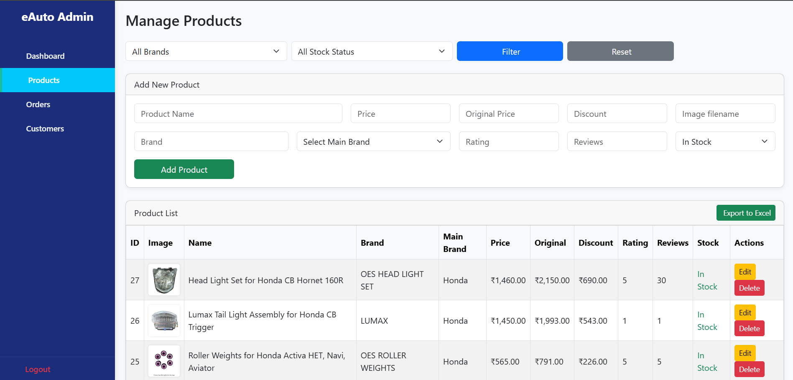
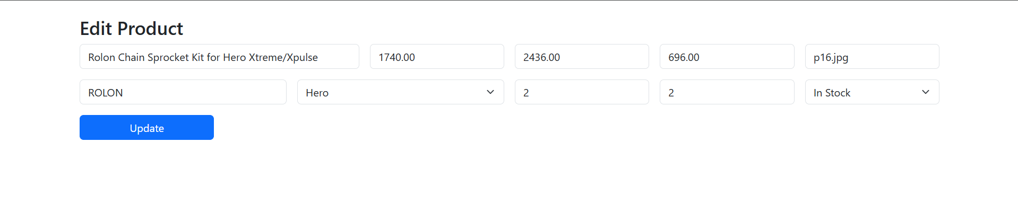
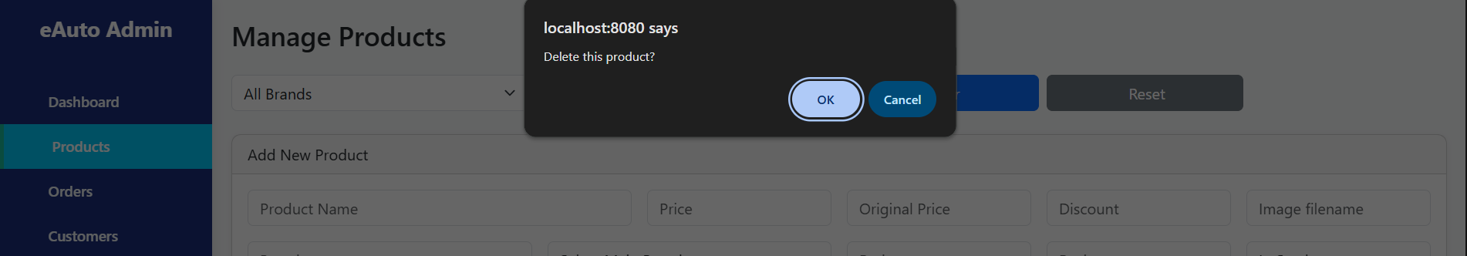
Admin Feature 2: Manage Products (Add/Edit/Delete)
CRUD operations on products
Product stock & pricing control

Slide 14
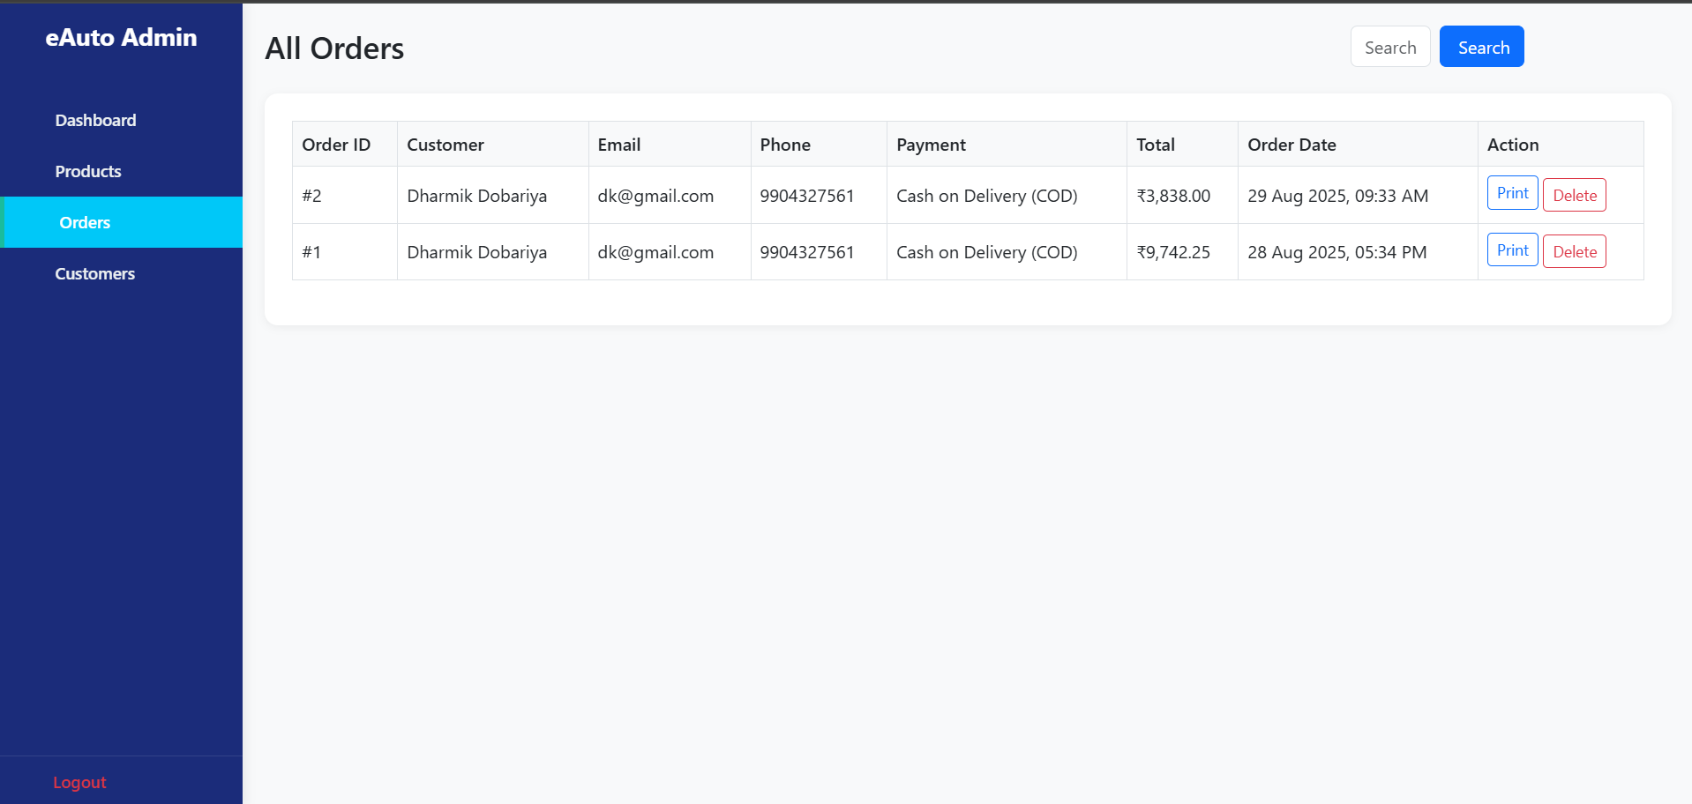
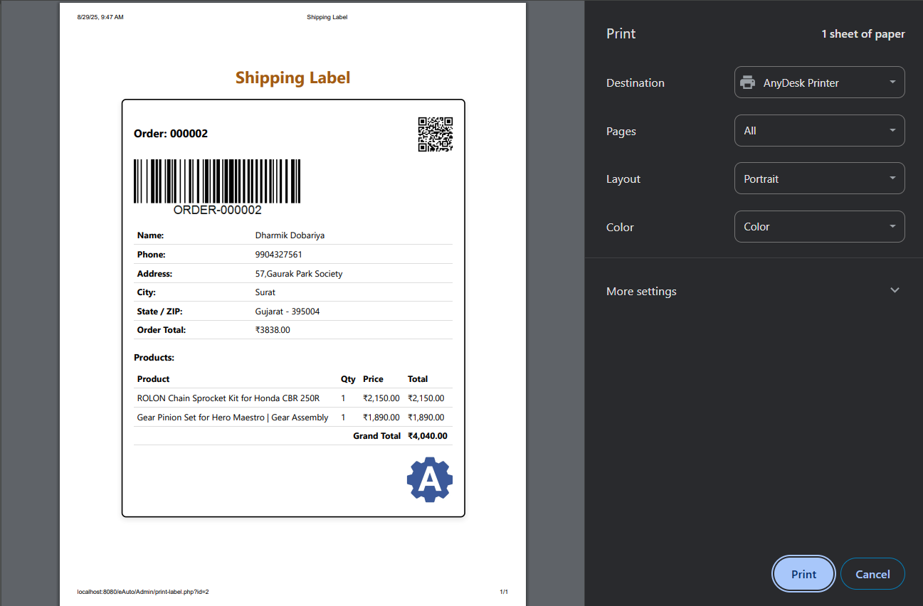
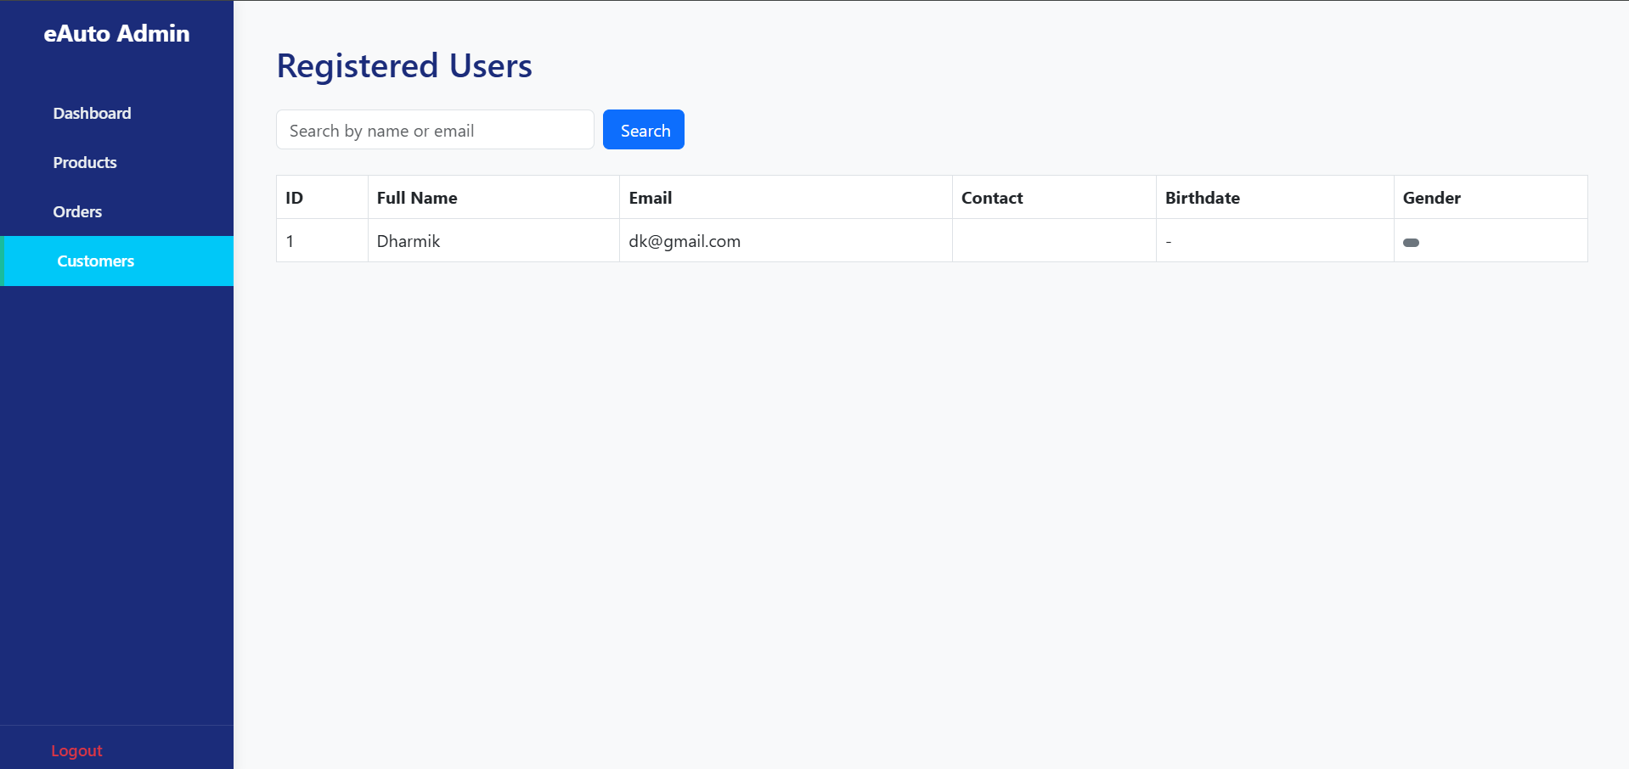
Admin Feature 3:
Manage Orders &
Users
View/approve/reject orders
Manage user details & roles

Slide 15
System
Analysis
Requirement Gathering – Collecting needs from users & admin.
Functional Requirements – Features the system must provide (e.g., login, cart, product management).
Non-Functional Requirements – Performance, security, scalability, usability.

Slide 16
System
Design
Technology Stack – Frontend: HTML + CSS + Bootstrap + AOS, Backend: PHP, Database: MySQL.
Database Design – ER Model, relationships, collections/tables structure.

Slide 17
ER Diagram Overview
Entities – User, Product, Cart, Order, Payment, Delivery, Admin
Attributes – e.g., User (UserID, Name, Email, Password), Product (ProductID, Name, Price, Stock)
Relationships –
  User ↔ Order (One-to-Many)
  Order ↔ Product (Many-to-Many)
  Product ↔ Cart (Many-to-Many)
  Order ↔ Payment (One-to-One)
  Order ↔ Delivery (One-to-One)

Slide 18
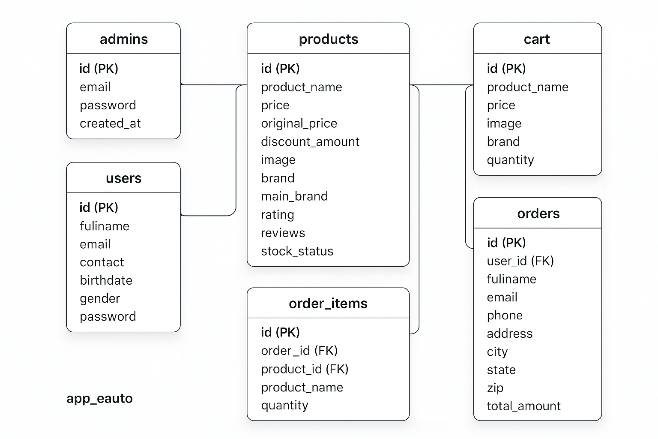
Final ER Model
Display the full ER diagram image (finalized version).
Add a small caption: “This ER Model represents the logical database design for eAuto system, showing entities, attributes, and relationships.”

Slide 19
Context Level DFD (Overview)
Show single process box (System) connected to:
User
Admin
Supplier
Payment Gateway
Input/Output flows

Slide 20
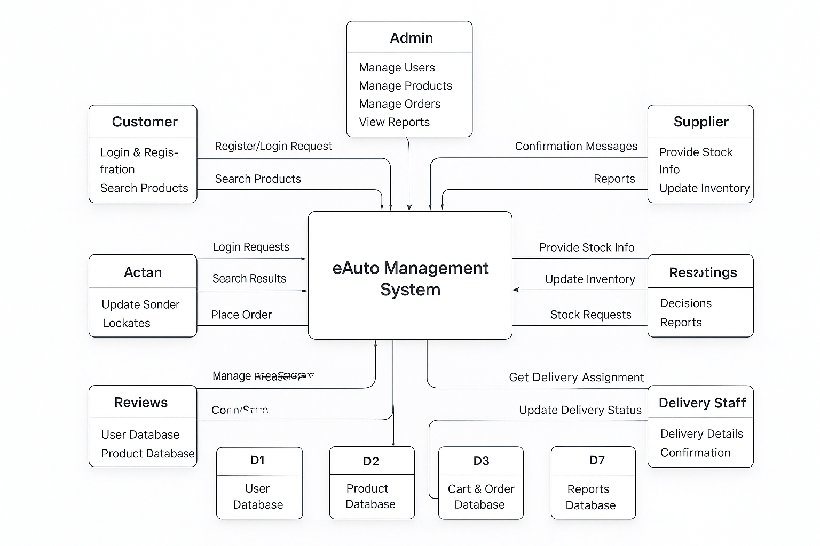
Level 0 diagram image

Slide 21
Level 1 DFD (Explanation)
Processes (Inside System):
1.0 Login & Registration – Input: Login/Register request → Output: Confirmation → Data Store: D1 User DB
2.0 Product Management – Input: Product search/update → Output: Product info → Data Store: D2 Product DB
3.0 Cart & Order Management – Input: Add to Cart/Place Order → Output: Order confirmation → Data Store: D3 Cart & Order DB
4.0 Payment Processing – Input: Payment details → Output: Transaction confirmation → Data Store: D4 Payment Records
5.0 Supplier & Inventory Management – Input: Stock info update → Output: Stock confirmation → Data Store: D5 Inventory DB
6.0 Delivery Management – Input: Delivery assignment → Output: Delivery confirmation → Data Store: D6 Delivery Records
7.0 Reports & Analytics – Input: Report request → Output: Sales/Stock reports → Data Store: D7 Reports DB

Slide 22
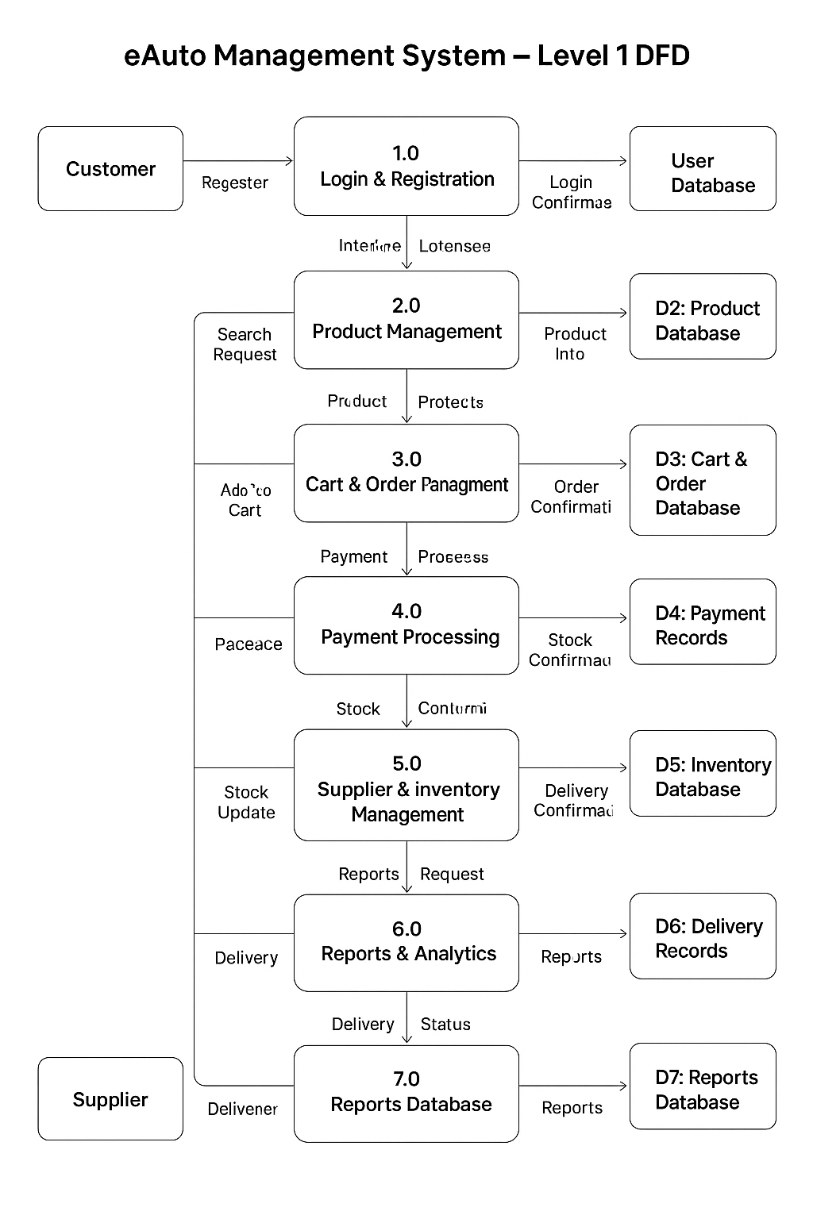
Level 1 diagram image
External Entities (Customer, Admin, Supplier, Delivery Staff)
Processes (1.0 – 7.0 inside system)
Data Stores (D1–D7)

Slide 23
Process 1.0: Login & Registration
User enters registration details / login credentials.
System validates input against User DB.
If valid → user session starts.
If invalid → error message shown.
Data stored in User Collection (MongoDB).

Slide 24
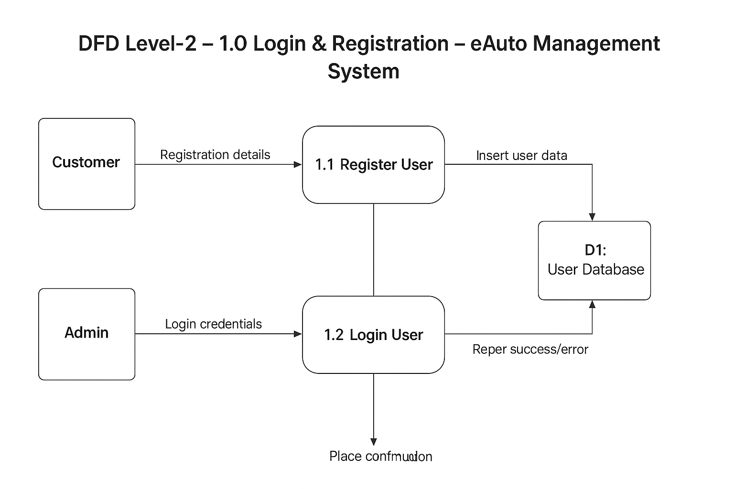
Level 1.0 diagram image

Slide 25
Process 2.0: Product Management
User/Admin requests products.
System queries Product DB (name, brand, category, price).
Product details displayed on UI.
Admin can Add/Edit/Delete products.
Updates stored in Product Collection.

Slide 26
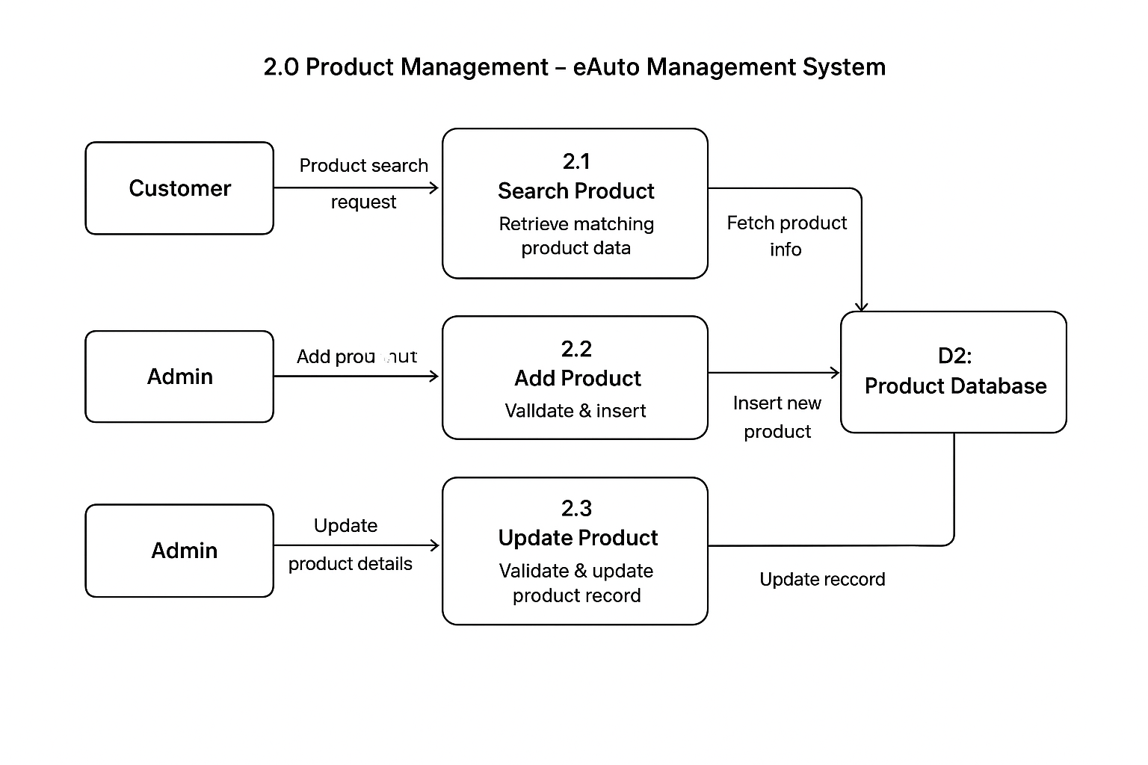
Level 2.0 diagram image

Slide 27
Process 3.0: Cart & Order Management
User adds/removes products from cart.
Cart data stored temporarily in Cart DB.
On checkout → system generates order.
Order stored in Order DB with user reference.
Admin updates order status (Pending, Shipped, Delivered).

Slide 28
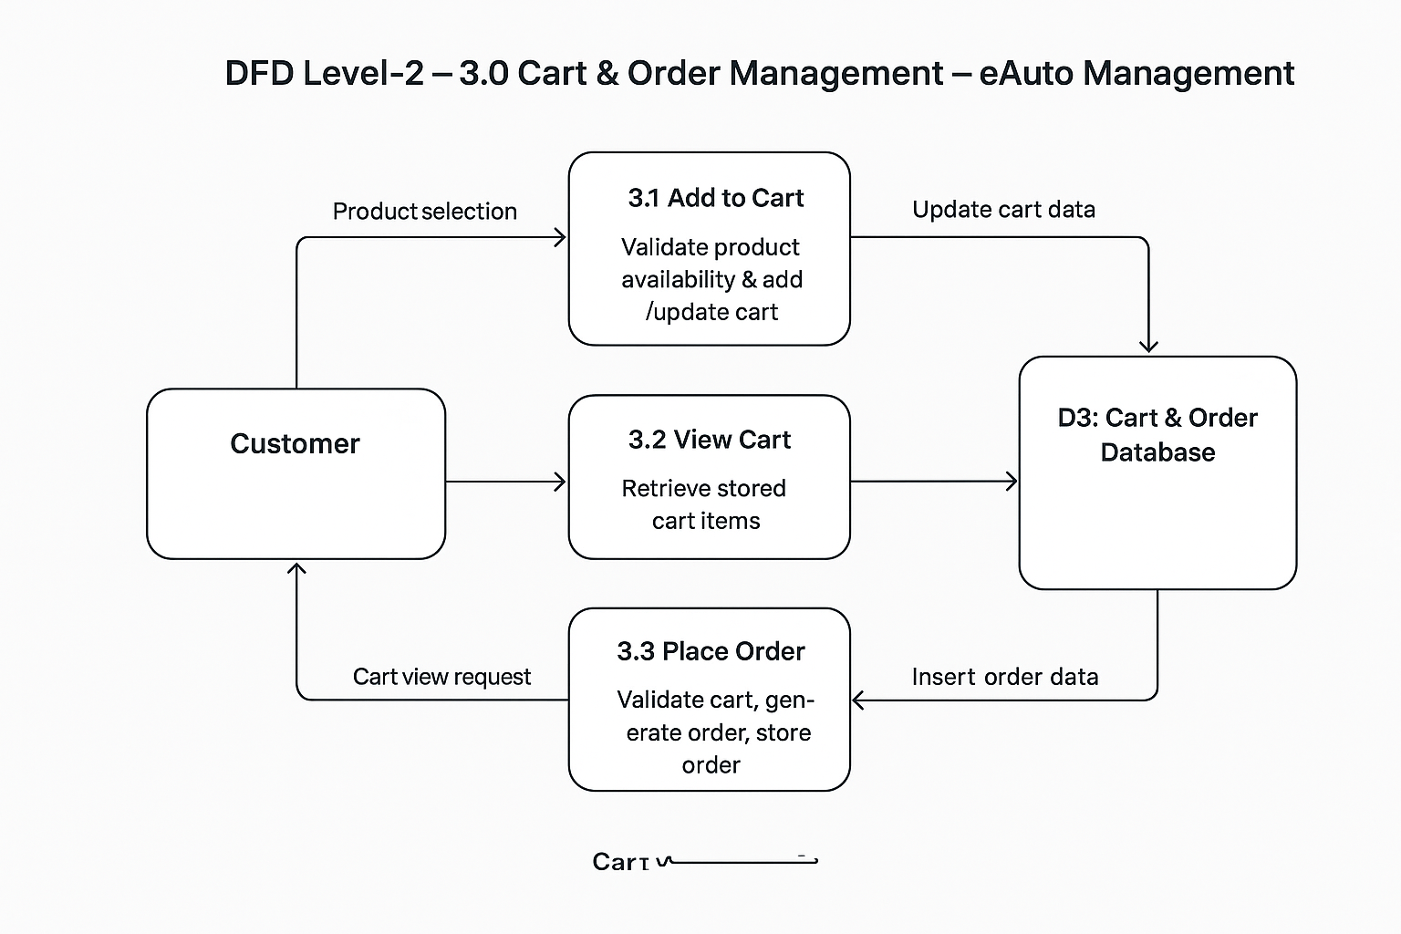
Level 3.0 diagram image

Slide 29
Process 4.0: Payment Processing
User selects payment method (Cash, Card, UPI, NetBanking).
System sends request to Payment Gateway.
Gateway verifies details and returns status.
If successful → confirmation stored in Payment DB.
If failed → system requests re-try.

Slide 30
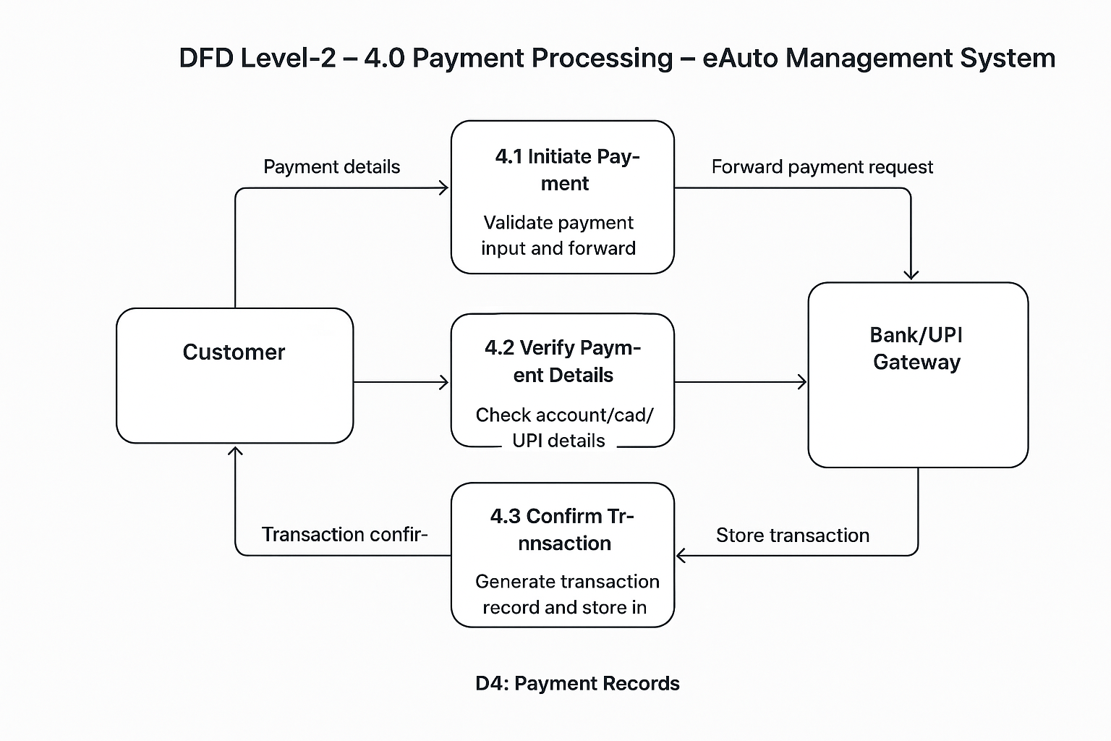
Level 4.0 diagram image

Slide 31
Process 5.0: Supplier & Inventory Management
Admin checks product stock levels.
Supplier updates stock into Supplier DB.
System syncs product availability.
Low stock alerts generated.
Updates reflected in Product DB.

Slide 32
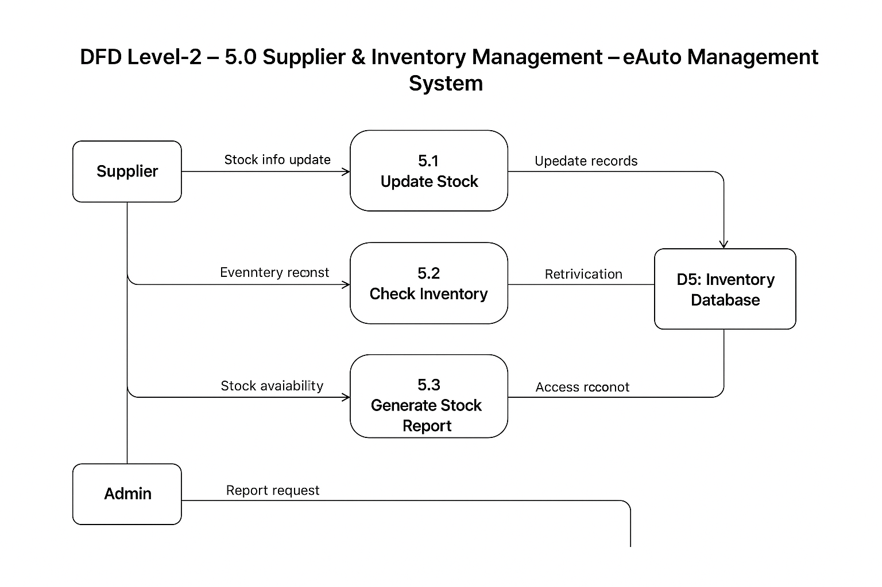
Level 5.0 diagram image

Slide 33
Process 6.0: Delivery Management
Order assigned to delivery staff.
Delivery details stored in Delivery DB.
Staff updates status (Out for delivery, Delivered).
User can track delivery in real time.
System sends delivery confirmation.

Slide 34
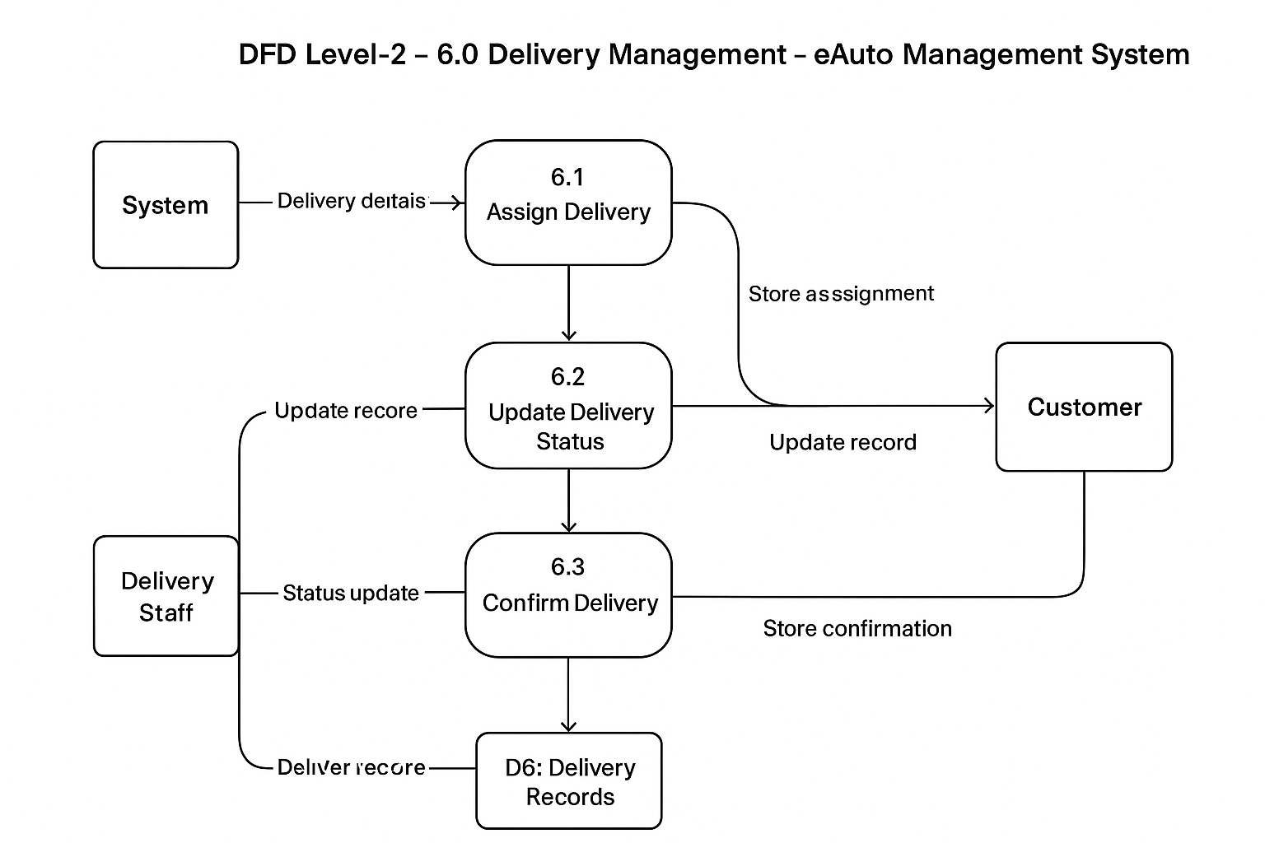
Level 6.0 diagram image

Slide 35
Process 7.0: Reports & Analytics
Admin requests system reports.
System collects data from Orders, Users, Products DBs.
Generates sales, stock & user reports.
Reports shown in graphical / tabular form.
Data stored in Reports Collection.

Slide 36
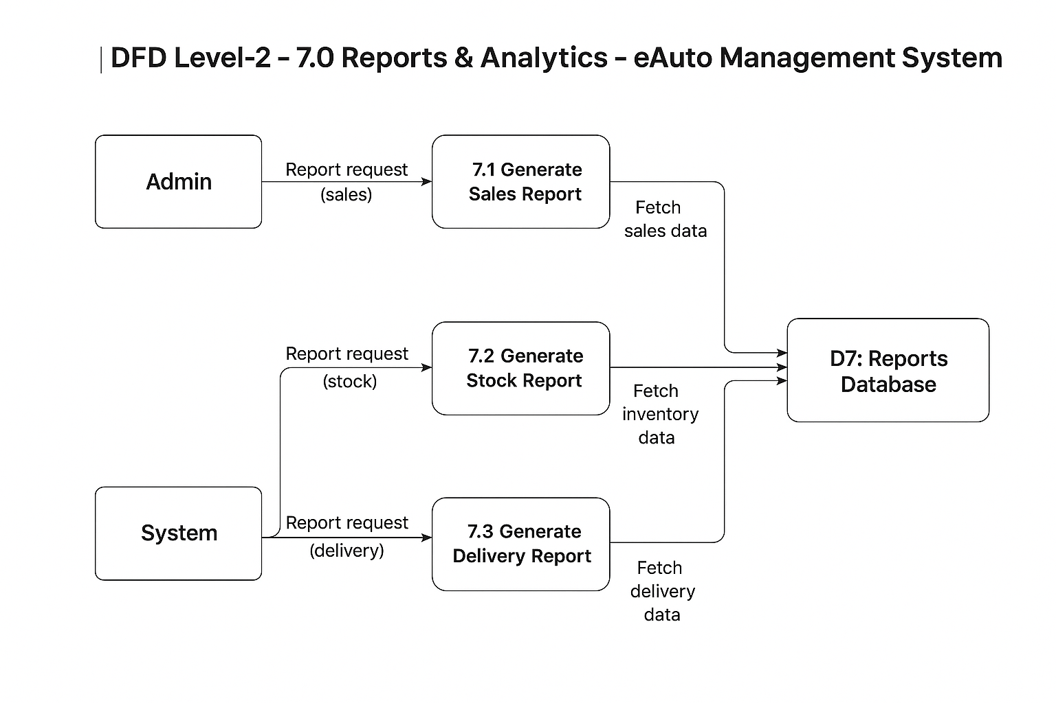
Level 7.0 diagram image

Slide 37
User Registration & Login Flow
User enters registration/login details.
System validates credentials against User DB.
If valid → access granted, session starts.
If invalid → error message shown.
Data stored in User Database.

Slide 38
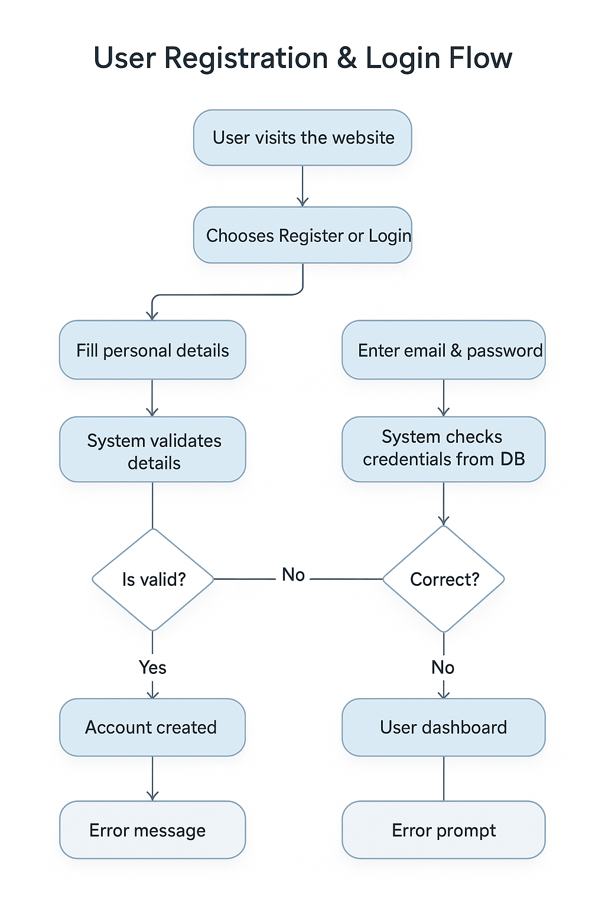
Flow Charts
image

Slide 39
Product Purchase Flow
User browses/searches products.
Selects desired product and adds to cart.
System checks stock availability.
If available → proceed to checkout.
If not available → show out-of-stock message.

Slide 40
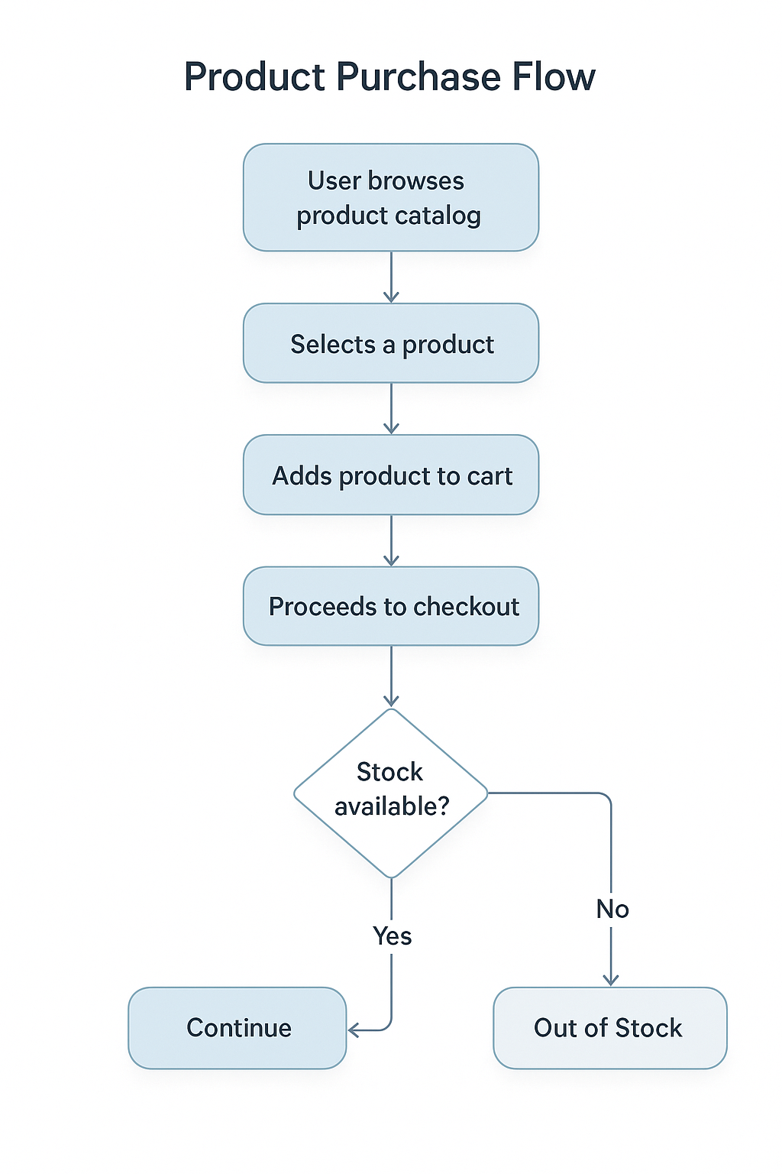
Flow Charts
image

Slide 41
Order Management Flow
User places order from cart.
Order details stored in Order DB.
Admin updates order status (Pending → Shipped → Delivered).
User can track order progress.
System notifies user at each stage.

Slide 42
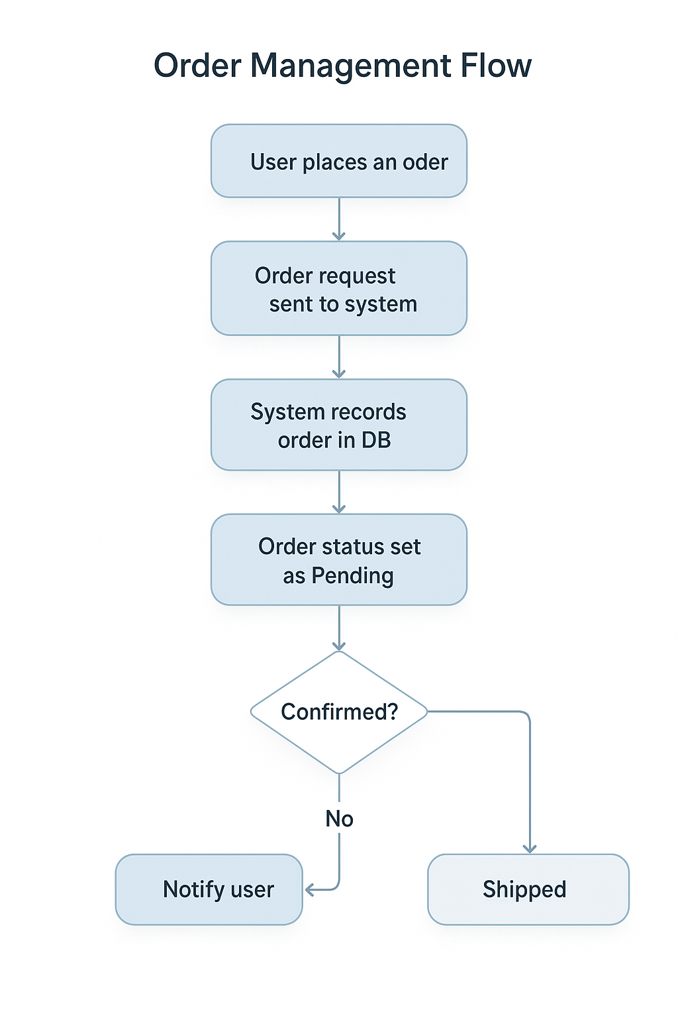
Flow Charts
image

Slide 43
Payment Processing Flow
User selects payment method (Cash, Card, UPI, NetBanking).
System sends details to Payment Gateway.
Gateway validates & returns success/failure.
On success → confirmation stored in Payment DB.
On failure → user prompted to retry.

Slide 44
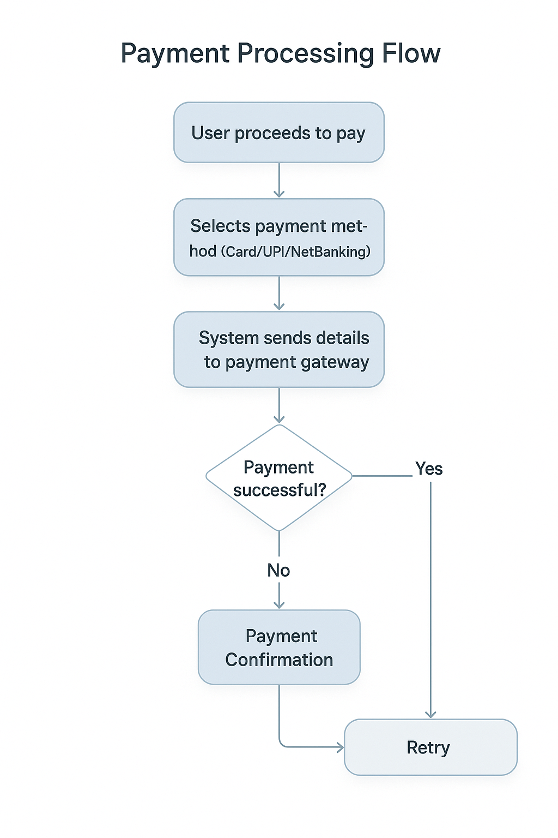
Flow Charts
image

Slide 45
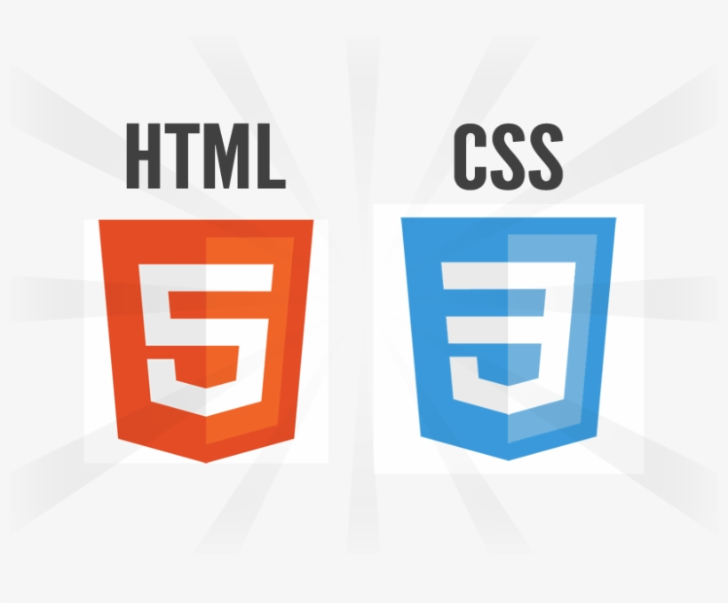


Frontend Implementation
HTML for structuring web pages
CSS for styling and layout design
Bootstrap for responsive and mobile-first design
AOS (Animate on Scroll) for smooth animations.
Provides interactive and mobile-friendly user experience.

Slide 46
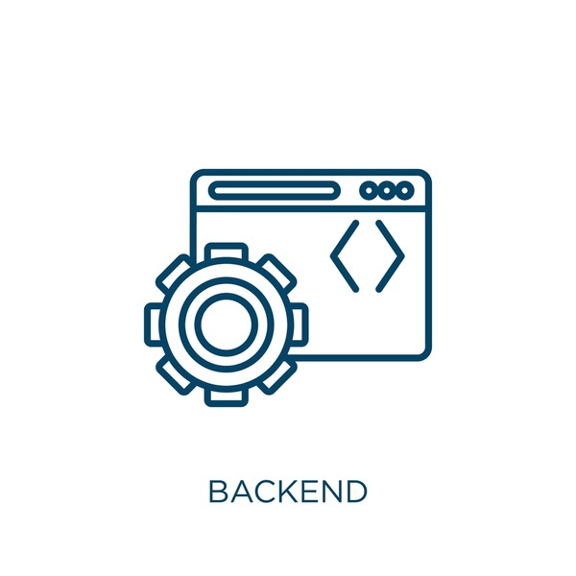

Backend & Database
Backend: Core PHP (mixed UI + business logic)
Database: MySQL (relational tables for Users, Products, Orders, etc.)

Slide 47

Security Features
Authentication & Session Management for secure access.
Input Validation to prevent errors & attacks.
Password Encryption for user credentials.
Role-based Access (User vs. Admin).
Protects data integrity & confidentiality.

Slide 48


Test Cases (Unit & Integration)
Unit Testing: Each module tested separately (Login, Cart, Checkout, etc.).
Integration Testing: Check data flow between modules (Cart ↔ Order ↔ Payment).
Ensures modules work correctly both individually and together.
Detects errors early in development.

Slide 49



User & Admin Testing
User Testing (UI/UX): Verify navigation, product browsing, cart, and order tracking.
Functional Testing: Validate real-time actions like add-to-cart, checkout, payment.
Admin Testing: Product management, order updates, report generation.
Confirms system works as expected for both roles.

Slide 50

Performance & Load Testing
Test system speed under normal and peak loads.
Verify response time for product search, cart, and payment.
Load testing with multiple users simultaneously.
Ensures scalability and reliability of the system.
Detects bottlenecks before deployment.

Slide 51
Limitations
of
the Project
🔹 Technical Limitations
Tight coupling of PHP with HTML/CSS made the codebase less modular and harder to maintain
MySQL database lacked flexibility for handling unstructured data
🔹 Functional Limitations
Limited payment options (Cash, UPI, Card only).
Reports are simple, not AI-driven.

Slide 52
Future Enhancements
Mobile App version (Android & iOS).
AI-based product recommendations.
Advanced reporting with data visualization dashboards.
Integration with third-party delivery partners (Swiggy Genie, Dunzo, etc.).
Multi-language and multi-currency support for wider audience.

Slide 53
Conclusion (Summary & Achievements)
🔹 Summary of Work
Designed & implemented eAuto – Bike Spare Parts E-Commerce Platform.
Frontend with HTML/CSS, Bootstrap & AOS for UI/UX.
Backend with PHP APIs integrated with MySQL.
Features include login, product browsing, cart, orders, payment, and delivery tracking.
🔹 Achievements
Fully functional e-commerce workflow (User ↔ Admin ↔ Supplier ↔ Delivery).
Secure login & session management.
Simplified cart and order management system.
Automated stock & delivery status updates.

Slide 54
Conclusion (Future Scope)
Develop dedicated mobile app (Android/iOS).
AI-based recommendations for personalized shopping.
Advanced analytics dashboards for Admin.
Multi-vendor & franchise support.
Integration with external payment & delivery APIs.

Slide 55

References

